Slide 1
Stakeholder Needs and Requirements Definition
Module 2

Slide 2
Agenda
Purpose of the Process
Requirements Elicitation
Operational Analysis
Stakeholders and Needs
Context Diagram
Stakeholder Needs to Stakeholder Requirements

Slide 3
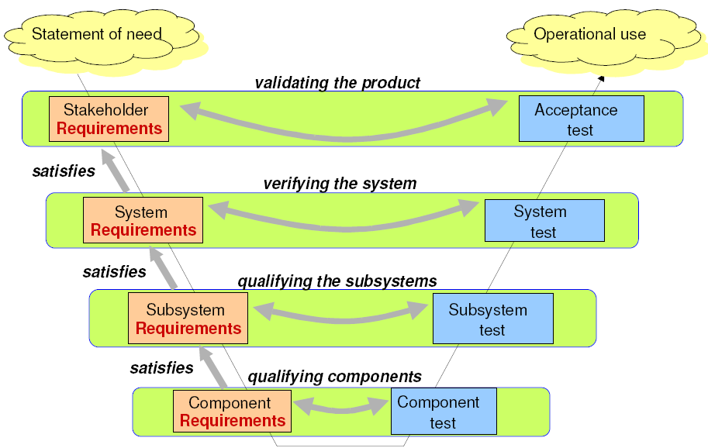
Problem
Domain
Did we build the right system?
Solution
Domain
Did we build the system right?

Slide 4
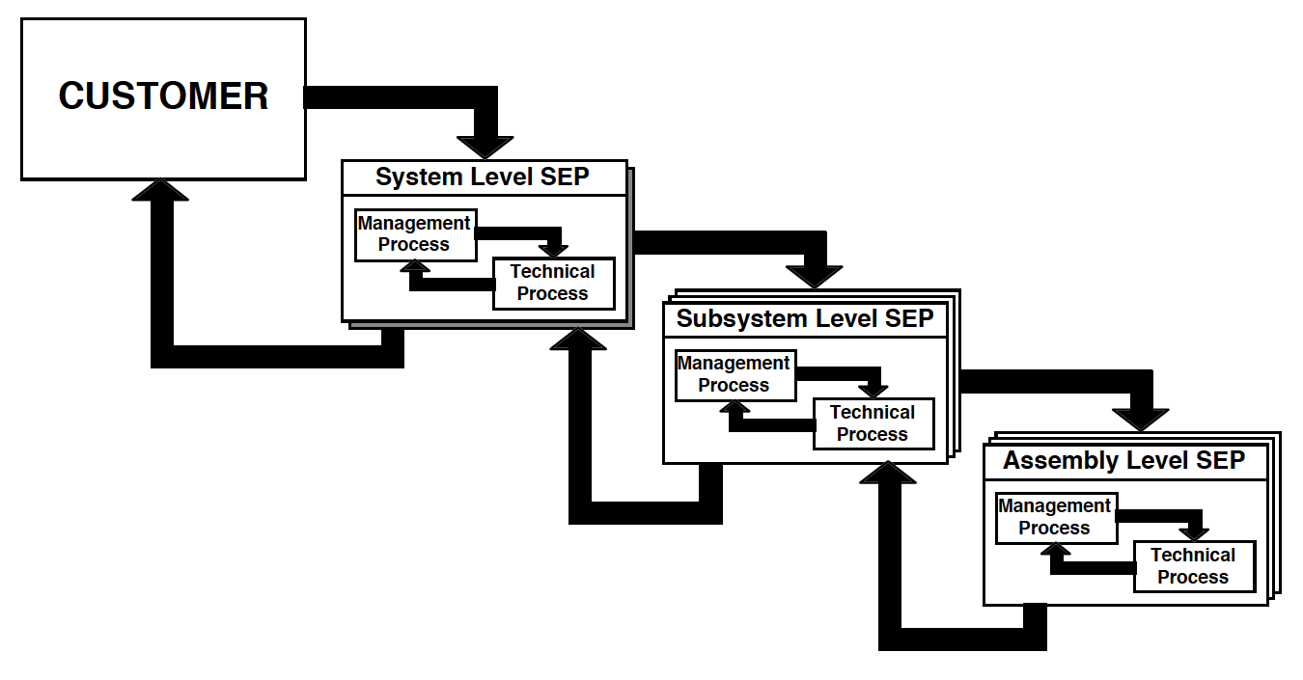
SE Process
Problem
Domain
Solution
Domain
Lockheed Martin Corporation
Notes:
Need for Tailoring
All 30 processes are not needed for every SOI, and at all levels

Slide 5
Purpose of the Process

Slide 6
Stakeholder Needs and Requirements Definition Process
The purpose of the Stakeholder Needs and Requirements Definition process is to define the stakeholder needs and requirements for a system that can provide the capabilities needed by users and other stakeholders in a defined environment.
(INCOSE Systems Engineering Handbook, v5)

Slide 7
Who is a Stakeholder?

Slide 8
Stakeholder Definition
Individual or organization having a right, share, claim, or interest in a system or in its possession of characteristics that meet their needs and expectations (ISO/IEC/IEEE 15288:2015)
An individual, team, or organization (or classes thereof) with interests in, or concerns relative to, a system. (TOGAF)
A stakeholder in an organization is (by definition) any group or individual who can affect or is affected by the achievement of the organization's objectives. (‘Strategic Management: A Stakeholder Approach‘, Freeman 1984)
Source : www.jamasoftware.com

Slide 9
What is the difference between Need and Requirement?

Slide 10
Need
Requirement
A requirement is “a statement that identifies a system, product or process characteristic or constraint, which is unambiguous, clear, unique, consistent, stand‐alone (not grouped), and verifiable, and is deemed necessary for stakeholder acceptability.” (INCOSE 2010)
A need may be defined as:
• A necessity
• An overall desire or want
• A wish for something that is lacking
Needs exist in the minds of people, and they are often expressed in fuzzy or general (ambiguous) terms.
Need: Something that is wanted or expected
Requirement: A formal structured statement

Slide 11
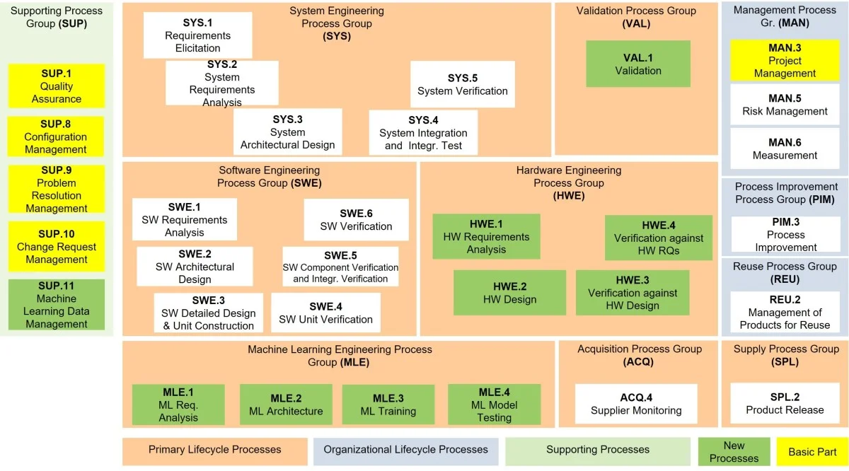
Automotive SPICE process reference model
image source: Invensity

Slide 12
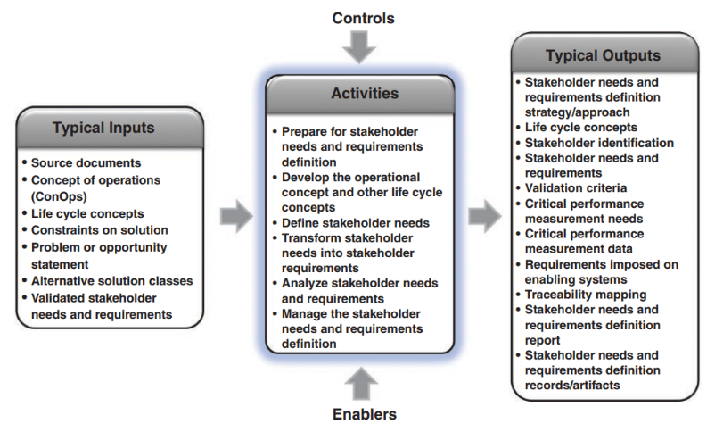
IPO Diagram
Source: INCOSE SE Handbook v5

Slide 13
Major Activities
Determine Stakeholders
Elicit Stakeholder Needs
Transform Stakeholder Needs into Stakeholder Requirements
Determine the need for any enabling systems, products, or services
Define Validation Criteria

Slide 14
Major Artifacts
Stakeholder Requirements Document
Stakeholder Needs / Requirements elicitation reports
Stakeholder Requirements Justification Documents
Traceability Report between stakeholder needs and requirements

Slide 15
Requirements Elicitation

Slide 16
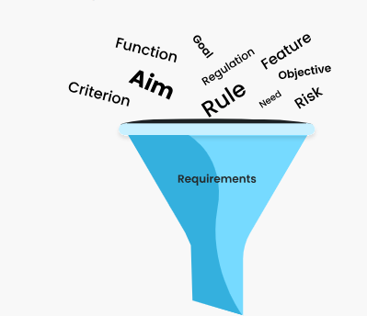
Requirements Elicitation
Starting Point: Need Statement
Self Generated OR Given by Customer
Purpose of Requirements Elicitation
Identify Stakeholders
Gather Stakeholder Needs and Requirements
Useful Skills
Systems Thinking
Domain Expertise

Slide 17
Challenges of Successful Requirements Elicitation
Finding the right stakeholders
Uncovering the best insights
Documenting the requirements
Planning for change
Understanding System Context
Source : www.jamasoftware.com

Slide 18
Typical Elicitation Workflow
RFP / Customer Requirements Document
Stakeholder Requirements
Sub-System Requirements
Refined Customer Requirements
Validated Customer Requirements (No Assumptions)
System Requirements
Basis for Development Team to work on
Actionable set of Requirements
SW Requirements
HW Requirements

Slide 19
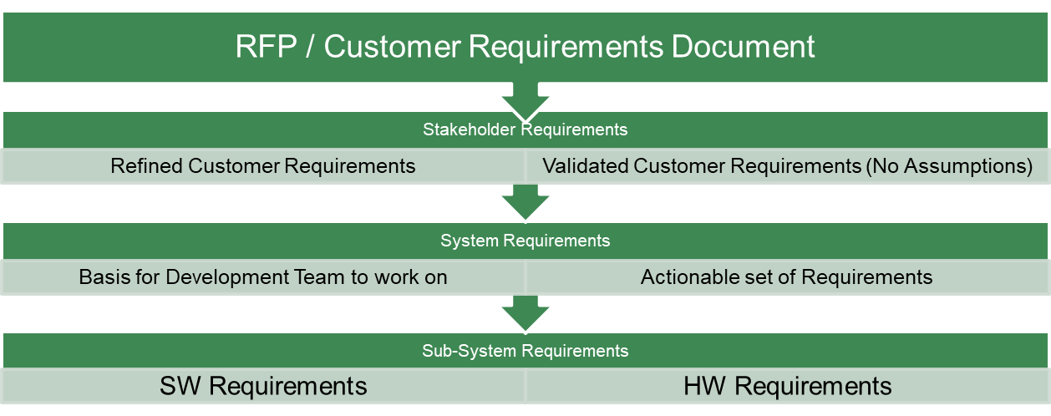
Typical Workflow
Analyse Customer Requirements
Analyse Stakeholder & Needs
Analyse Context
Perform Operational Analysis / Use Case Analysis
Refine Customer Requirements into Stakeholder Requirements

Slide 20
Team Exercise - Background
EcoIndia is a leading EV company specializing in passenger vehicles. They wish to add a new feature of “Blind Spot Warning System” to their upcoming Sedan Platform.
EcoIndia has initiated a RFP, and shared a High level Requirements Document. Your team has been tasked to conceive and develop this Feature.

Slide 21
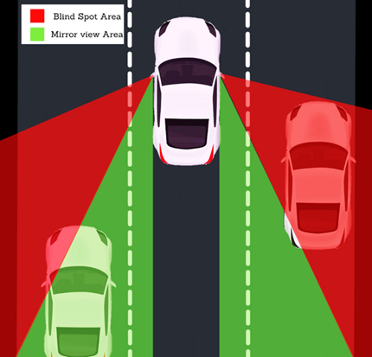
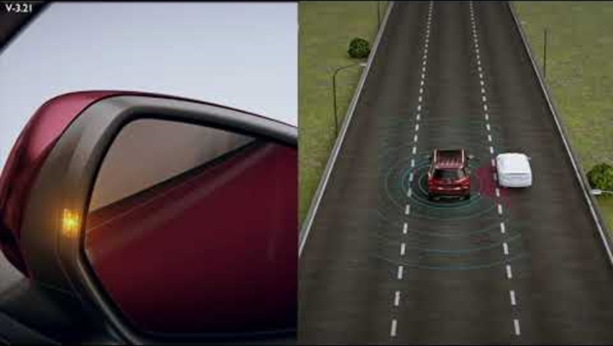
Background
Your SOI (System of Interest) : Blind Spot Detection (BSD)

Slide 22


Slide 23
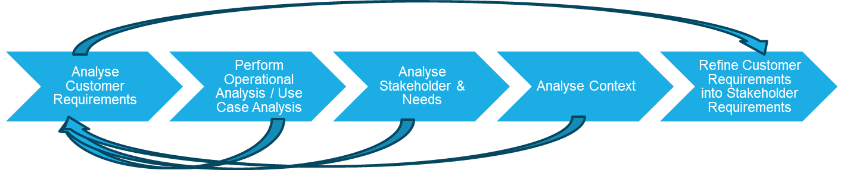
Elicitation Workflow

Slide 24
Exercise 2.1
Read the HLD
Discuss as a group
Do you have any questions for the Customer?
What assumptions are you making?

Slide 25
Operational Analysis

Slide 26

Elicitation Workflow

Slide 27
Use Cases
A use case captures a contract between the stakeholders of a system about its behavior.
It describes the system’s behavior under various conditions as it responds to a request from one of the stakeholders, called the primary actor.

Slide 28
Description of a Use Case
Use case name: a unique name for this use case
Scenario: the instance of the use case being documented
Triggering Event: the business event that initiates or triggers this use case
Brief Description: a one or two sentence description of the results of the use case
Related use case: any included use cases, or use cases that “include” this one
Stakeholders: other persons, other than the actors, who have an interest in the results or successful completion of this use case
Precondition: The state of the system before the use case begins
Postcondition: the state of the system at the successful completion of the use case
Flow of activities: a step by step sequence of the actions by the actor and the system internal to the use case
Exception conditions: any exception conditions that cause the system not to follow the expected flow of activities or that cause the use case to terminate abnormally
Source Systems Analysis and Design in a Changing World, seventh edition
Notes:
https://www.usability.gov/how-to-and-tools/methods/use-cases.html#:~:text=A%20use%20case%20is%20a,when%20that%20goal%20is%20fulfilled.

Slide 29
Operational Scenarios
Description of an imagined sequence of events that includes the interaction of the product or service with its environment and users, as well as interaction among its product or service components. (ISO/IEC 2011)
A set of actions or functions representing the dynamic of exchanges between the functions allowing the system to achieve a mission or a service. (Created for SEBoK)
Stories which describe the expected utilization of the future system in terms of actions. (Created for SEBoK)

Slide 30
Buying an SUV
Source: www.cardekho.com

Slide 31
Operational Scenarios for a Smart Phone
Daily Communication
Internet Browsing
Navigation and Travel
Media Consumption
Photography and Videography
Productivity and Work
Connectivity and Networking
Customization and Personalization
Emergency Situations
Health and Fitness
Security and Authentication
Gaming and Entertainment
Notes:
Taking phone to office
Using phone while travelling in Car
Charging phone at home
Taking phone on a sightseeing trip

Slide 32
Concept of Operations (ConOps)
The concept of operations defines at a conceptual level how the system actually operates when it delivers value.
ConOps is a formal document that employs users’ terminology to describe the rationale, uses, capabilities, and benefits of a system

Slide 33
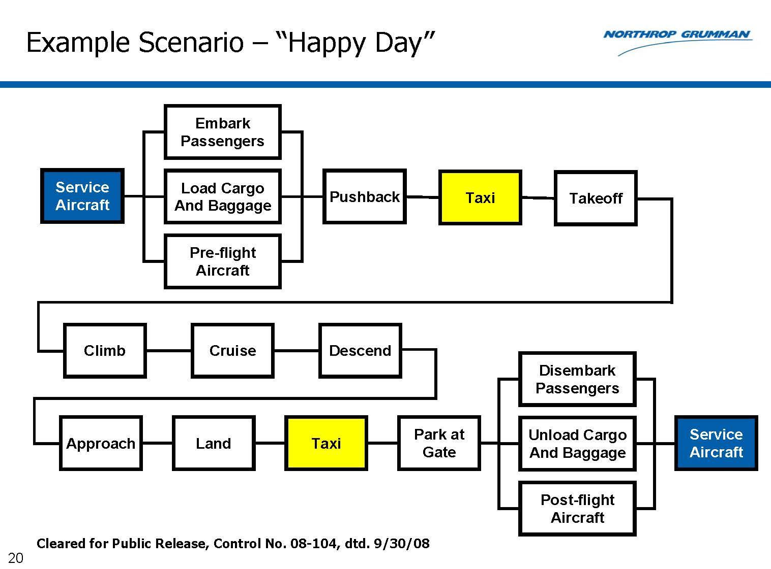
ConOps – Commercial Aircraft
Notes:
This diagram depicts the various stages of operation of the aircraft. It helps identify various states.
So while designing a system, we might not be able to think of various operational scenarios of a system. This will help develop a comprehensive list of requirements, and required functionalities.

Slide 34
ConOps: Going to Work (physically)
Get Ready (for the day)
Get Set (for going to office)
Go (from home to office)
Get Unset (reach desk)
Get Unready (settle at desk; get ready to work)

Slide 35
ConOps: Going to Work (physically)
Get Ready (for the day) | Set the alarm AM → PM | Blocking calendar Wromg date | Wake up at set time - snooze | Get dressed up No water, irin clothes
Get Set (for going to office) | Packup bag (ID card , Laptop, keys, charger) | Unlock the car | Lock the room | Ensuring fuel in car
Go (from home to office) | Ingress | Navigation. Wrong destiation | Drive. Accident, traffic police
Get Unset (reach desk) | Park | Lock car | walk
Get Unready (settle at desk; get ready to work) | Open laptop | Login | Check calendar

Slide 36
ConOps: what could go wrong?
Get Ready (for the day)
Get Set (for going to office)
Go (from home to office)
Get Unset (reach desk)
Get Unready (settle at desk; get ready to work)

Slide 37
What are the benefits of ConOps
Enables success on the left side of the V
Effective stakeholder identification and requirements elicitation
Enables early, high-level understanding of the System of Interest
Bridges the gaps between various stakeholders
Ensures requirements and designs are aligned with end-user expectations

Slide 38
Exercise 2.2
For your BSD(SOI),
Identify a few Operational Scenarios / Use Cases (Stories which describe the expected utilization of the future system)
Create a ConOps for any one Operational Scenario (As a Block Diagram, List, or Ready - Set - Go Framework)
Identify and list stakeholders that are involved in the ConOps

Slide 39
Stakeholders & Needs

Slide 40
Elicitation Workflow

Slide 41
Identifying Stakeholders
Think about the entire life-cycle of the system
Different stakeholders during different life-cycle stages
Think about “A day in the life of the system”
Consider breaking down broad categories of stakeholders
Categories of ‘Users’
Nature of Interest in project/system
“Friendly” Stakeholders; Beneficiaries (interested in project/system success)
“Neutral” Stakeholders (don’t care, but critical for success)
“Unfriendly” Stakeholders (interest in project/system failure)
Lifecycle Stage
Internal (Solution Domain)
External (Problem Domain)

Slide 42
Needs Elicitation Techniques
Elicitation Techniques
Brainstorming
Stakeholder Focus
Interviews
Surveys/Questionnaires
Feedback and Document Analysis
Interface Analysis
Observation of Comparable Products
Prototyping
Models and Diagrams
Workshops or Focus Groups
Analysis
Source : INCOSE Needs and Requirements Manual

Slide 43
Forms of Documenting Elicitation Outcomes
Representations
Diagrams/drawings
Models
Lists
Tables
Text
Methods
Operational Scenarios
Use Cases
User Stories
ConOps / OpsCons

Slide 44
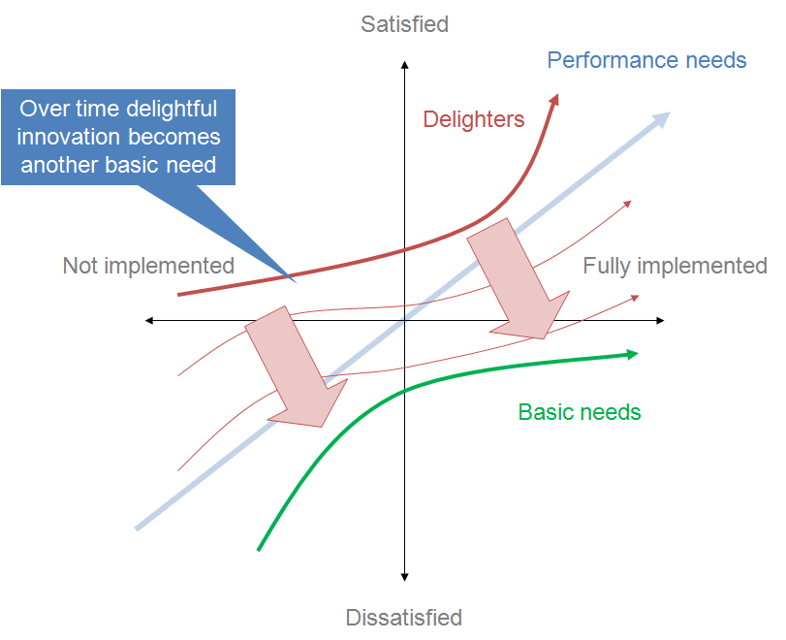
Needs characterization (Kano Model)
Should have
Must have: Its presence is absolutely essential, and I would regret its absence.
Should have: I would be satisfied by its presence, and I would regret its absence.
Might have: I would be satisfied by its presence, but I would not regret its absence
Might have
Must have
By Craigwbrown - Own work, CC BY-SA 3.0, https://commons.wikimedia.org/w/index.php?curid=23262780

Slide 45
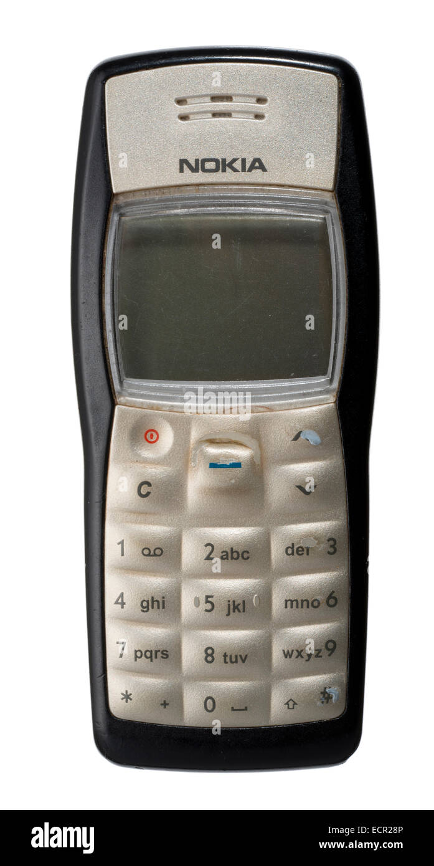
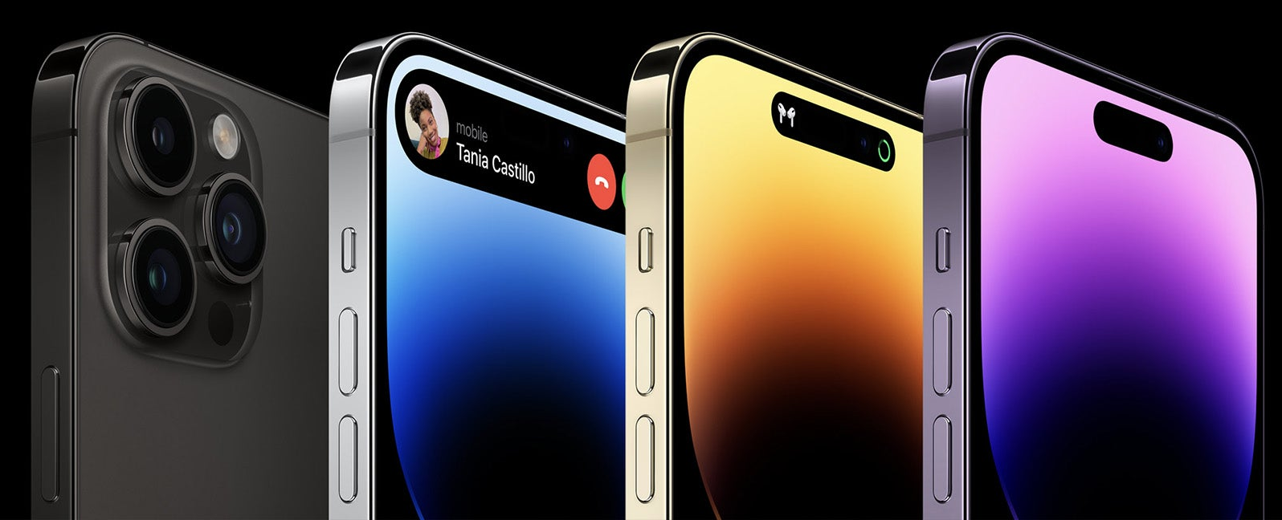
Open Discussion :Evolution of Needs
What is the importance of the Kano model in Requirements Elicitation?

Slide 46
Types of Needs
Expressed Needs
Retained Needs
Specified Needs
Perceived Needs
Realized Needs
Real Needs
Notes:
Pick some needs from elicitation exercise

Slide 47
Best Practice
From stakeholders (particularly customers / end-user), elicit Needs; NOT Requirements
Customers / end-users will typically want a solution
Ask them about their problems
A system that satisfies elicited requirements need not solve the problem!

Slide 48
Exercise 2.3
For your BSD(SOI):
Identify various Stakeholders
Identify a few Needs that each Stakeholder may have (i.e., stakeholder responses to the question “What do you expect from the SOI”?)
[use Operational Scenarios and ConOps Exercise as a reference]
Use sheet ‘Ex 2.3– STK’ and ‘Ex. 2.3 STK Needs’ in ‘Requirements Worksheet’

Slide 49
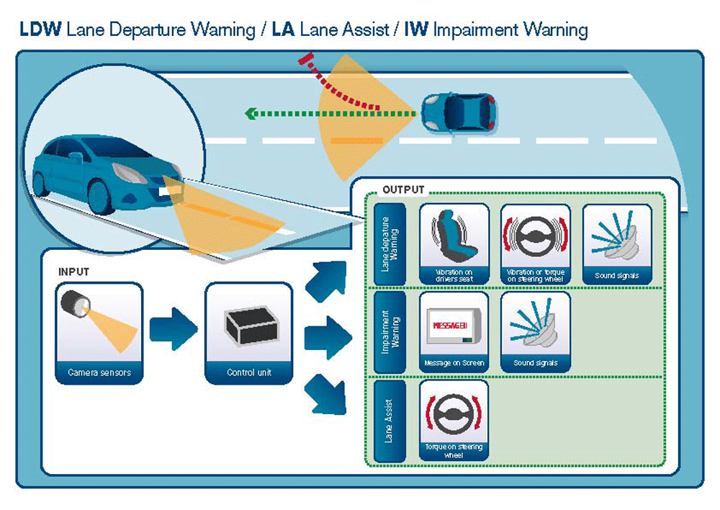
Open Discussion
What are some challenges which Could be identified for LDW ?
What will be your “needs” for LDW ?
What solutions are you thinking?

Slide 50
Categories of Elicitation Problems
Problems of Scope
Problems of Understanding
Problems of Volatility
Problems of Resistance (non-cooperation)
Source: Christel and Kang, 1992; Saiedian and Dale, 1999

Slide 51
1. Problems of Scope
Gathered requirements may provide too little or too much information
Unnecessary design information may be given
Boundary of the system may be ill-defined

Slide 52
2. Problems of Understanding
Stakeholders have incomplete understanding of their needs
Stakeholders have incomplete understanding of technologies and capabilities (of the system of interest)
Obvious information can be omitted
Stakeholders may have conflicting views
Needs are vague and untestable
Use of imprecise terminology, sentence structure

Slide 53
3. Problems of Volatility
Stakeholder needs evolve over time
Stakeholders’ awareness / knowledge of their needs may increase during development activities
If new / modified requirements are not addressed, the system may not be acceptable

Slide 54
4. Problems of Resistance
Time Resistance
Person does not have the time to meet
Overload Resistance
Person wants more information that what you provide
Silence Resistance
Person does not react or respond to questions
Impracticality Resistance
Person states that what you are stating will not work in the real world
Compliance Resistance
Person agrees with everything you say

Slide 55
Context Diagram

Slide 56
Elicitation Workflow

Slide 57
Context Analysis
The circumstances that form the setting for an event, statement, or idea, and in terms of which it can be fully understood. - Oxford Dictionary
Describes the system relationships and environment, resolved around a selected system-of-interest. - (Flood and Carson 1993) SEBoK
Diagram defining the highest-level view of a system in its environment. - (Flood and Carson 1993) SEBoK

Slide 58
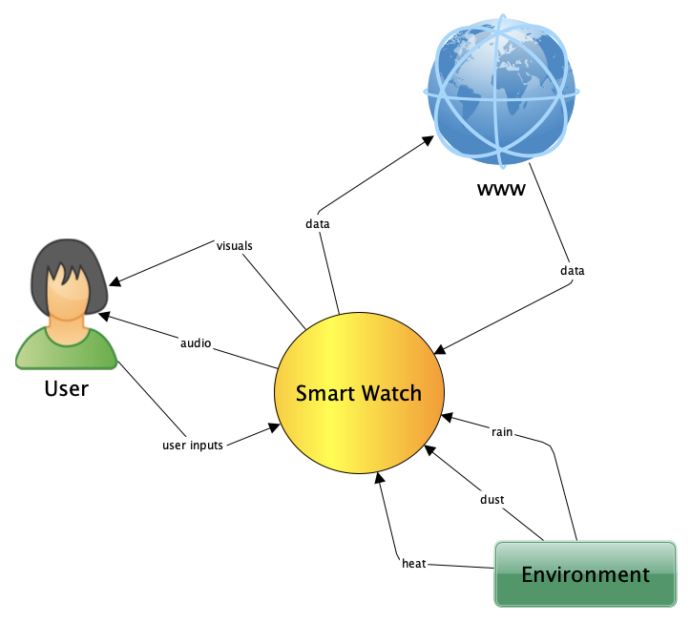
Context Diagram – Smartwatch [Example]
Charger
Power
Vitals
Smart Device (Android & IOS) & Windows
strap
Data (Over Bluetooth)
Notes:
System Boundaries and External Interfaces are established via the Context Diagram
Can you identify what is the system of interest here – SYSTEM AS A BLACKBOX
Is the boundary clear?
Anything missing?

Slide 59
Context Diagram – Smartwatch [Example]
Notes:
System Boundaries and External Interfaces are established via the Context Diagram
Can you identify what is the system of interest here – SYSTEM AS A BLACKBOX
Is the boundary clear?
Anything missing?

Slide 60
Context Diagram – Smartwatch [Discussion]
Smart device
Charger / Power
biometric
What are some missing interfaces?
Notes:
System Boundaries and External Interfaces are established via the Context Diagram
Can you identify what is the system of interest here – SYSTEM AS A BLACKBOX
Is the boundary clear?
Anything missing?

Slide 61
Context Diagram
Also known as “External Systems Diagram”
Identifies / defines:
System scope/boundary
Interactions with external environment / systems / entities
External events and external inputs to which the system must respond
Data / information to be produced by the system
External data / information required by the system

Slide 62
Exercise 2.4
For your Blind Spot Detection System (SOI):
Give a name
Draw a Context Diagram
Identify external entities
Draw arrows indicating the direction of flow of data / information
Label the arrows
Go back to HLD, and see if any interface requirements are missing

Slide 63
Stakeholder Needs to Stakeholder Requirements

Slide 64
Elicitation Workflow

Slide 65
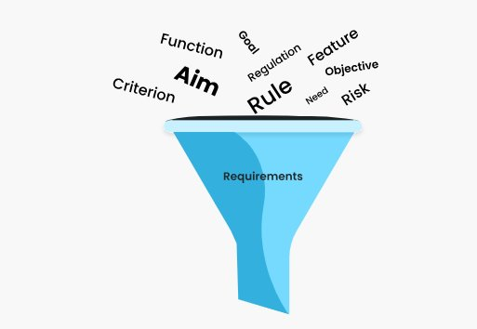
Needs to Requirements
Stakeholder
Needs
Stakeholder
Needs
Stakeholder
Requirements
Clear, consolidated, documented set of statements
To be “confirmed” by the respective stakeholders
Will be the basis for “System Validation”
Stakeholder
Needs

Slide 66
Stakeholder Requirements
Statement of
Need/Opportunity
Literature Search
Legislation
Patents
Reports
Proceedings
Reference books
Manufacturers of
competitive and
analogous products
Official and private
Representative bodies
Statistical
data
Product data and
specification
Market data
publications
Identification of
market trends
Questionnaire
Parametric analysis
Official opinions
and reactions to
products in use
Graphs of
market trends
Identification of
market gap
Matrix analysis
Needs analysis
VOC
Choice of best of
competition
“Stakeholder”
requirements

Slide 67
Transforming Needs to Requirements
System Validation is based on Stakeholder Requirements
Additional interactions with the Stakeholders will be needed
Ask “Why”; try to get to the ‘Real Needs’; document the ‘What’, not ‘How’
Some stakeholder needs may give rise to multiple stakeholder requirements
Requirements must be ‘Testable’ - must be able to prove that they are met
Confirm with the Stakeholder that the ‘proof’ will be acceptable
Resolve any issues related to considering the full list of ‘Stakeholder Requirements’ as one set.

Slide 68
Requirements Engineering Effort (thus far)
Identifying Stakeholders
Stakeholder
Needs
Stakeholder
Requirements

Slide 69
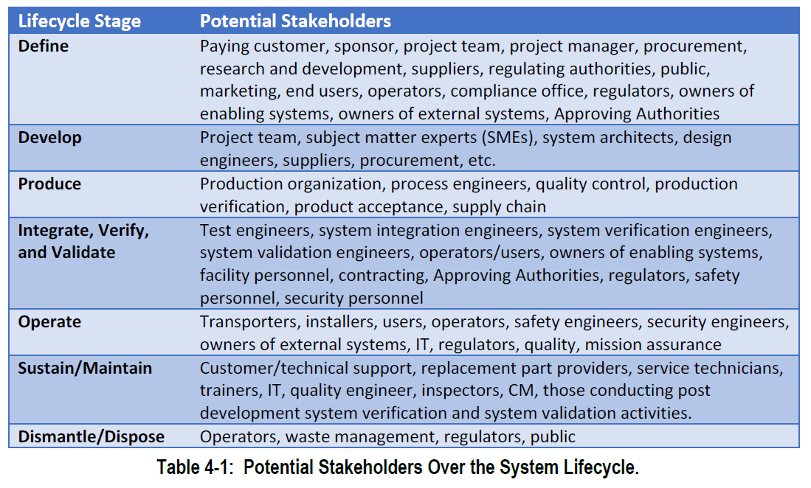
Potential Stakeholders across the System Lifecycle
What we got from ConOps / UseCases
Source : INCOSE Needs and Requirements Manual

Slide 70
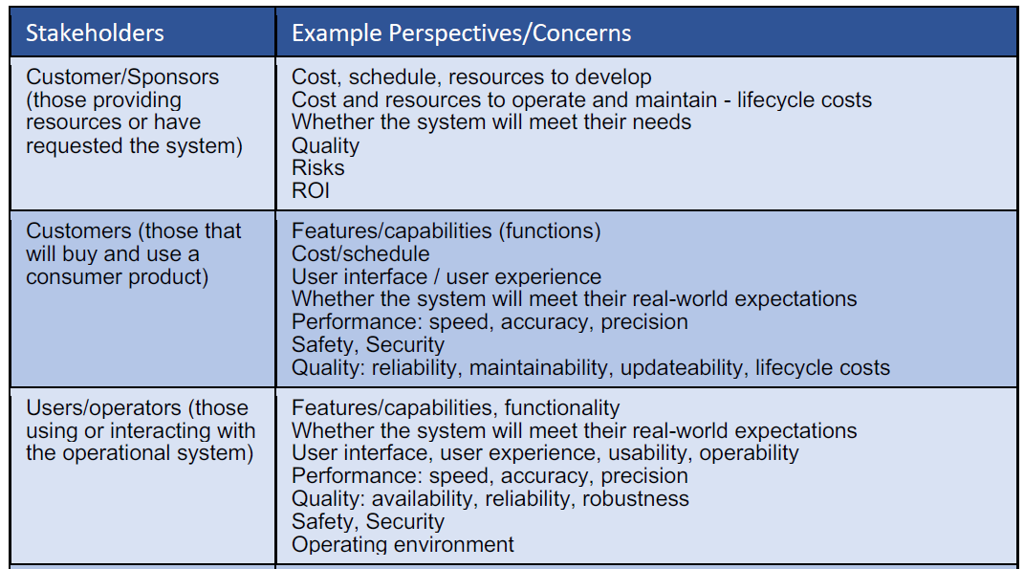
Typical Stakeholders’ Perspectives & Concerns (1)

Slide 71
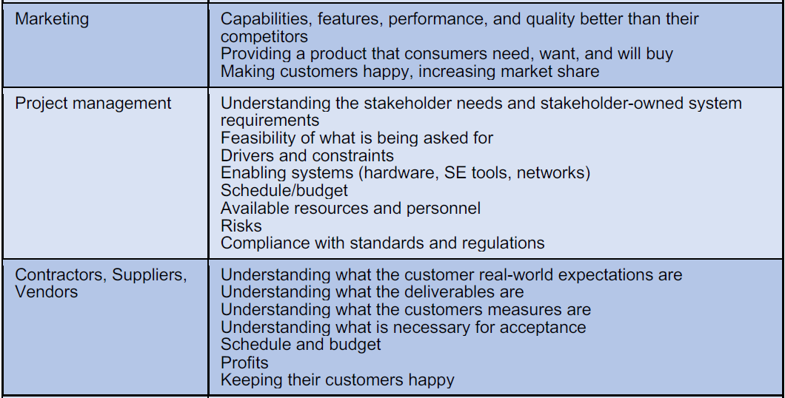
Typical Stakeholders’ Perspectives & Concerns (2)

Slide 72
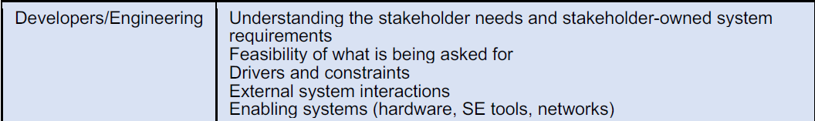
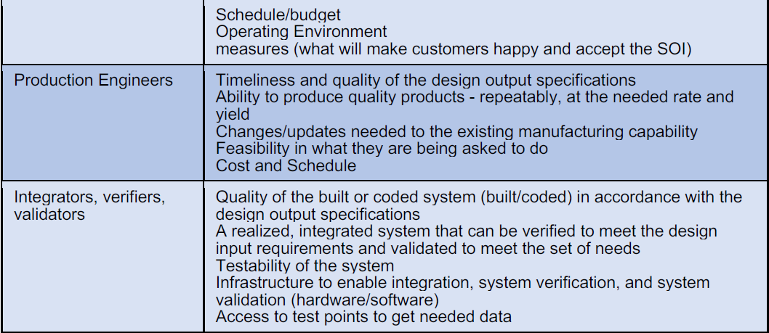
Typical Stakeholders’ Perspectives & Concerns (3)

Slide 73
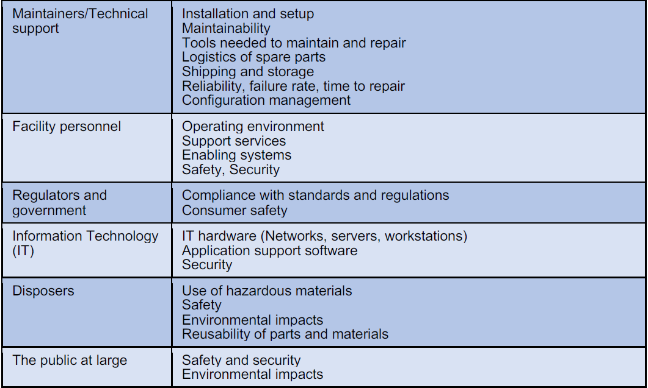
Typical Stakeholders’ Perspectives & Concerns (4)

Slide 74
Exercise 2.5
Convert the Stakeholder Needs to Stakeholder Requirements [Sheet..]
Discuss and share the requirements that were not existing or changed from HLD.

Slide 75
Exercise 2.6
As an internal stakeholder (i.e. BSD Design Team), what stakeholder needs/requirements would you provide to the Vehicle-level Systems Engineering Team?
How would these requirements change from vehicle-to-vehicle

Slide 76
Stakeholder Needs (Vehicle Climate Control Unit)
# | Name | Text | Stakeholder
1 | SN-1 Stakeholder Needs
2 | SN-1.1 User Needs |  | User
3 | SN-1.1.1 Sound Level | “Climate control unit in max mode shall not be louder than engine.” | User
4 | SN-1.1.2 Manual Control | “I should be able to start and stop climate control by myself.” | User
5 | SN-1.1.3 Heating & Cooling | “The unit must be able to heat and cool.” | User
6 | SN-1.1.4 Energy Consumption | “I'd like the unit to consume as little energy as possible.” | User
7 | SN-1.1.5 Ambient Temperature | “I want to see the ambient temperature on the screen or some other output device.” | User
8 | SN-1.1.6 Desired Temperature | “It should be a possibility to easily specify the desired temperature.” | User
9 | SN-1.1.7 Comfortable Temperature | “I'd like to feel comfortable temperature while being in the cabin.” | User
10 | SN-1.2 Design Constraints
11 | SN-1.2.1 Total Mass | “Mass of the unit shall not exceed 2 percent of the total car mass.” | Vehicle Product Owner / System Engineer
Source : MagicGrid Book of Knowledge

Slide 77
The End

